Slide 1

SWAMI VIVEKANANDA INSTITUTE OF MODERN STUDIES
Project Name – Online Complaint Portal
Course – BCA (5th Sem.)
Year – 3rd year
– Group Members –
1. Indraneel Bhattacharjee (3510121001)
2. Abhishek Kumar (35101221037)
3. Deepak Kumar Ram (35101221049)
4. Suman Adhikary (35101221042)
5. Rabi Sahoo (35101221036)

Slide 2
MINOR PROJECT PRESENTATION
“ ONLINE COMPLAINT PORTAL ”

Slide 3

CONTENTS
Introduction
Literature survey
Objectives
About/theory/principle/diagram if
Why this project
Applications/Working
Reference

Slide 4
ACKNOWLEDGEMENT
We owe a great deal of thanks to those great people who helped and supported us during this project. Our deepest thanks to MADHUMITA SAHA MAM who is our project mentor and also the Guide of the project for guiding and correcting various documents and different projects’ aspects of us with attention and care. They have taken pain to go through the project and make necessary correction as and when it was needed.
We would also thank DIPANKAR sir, RAJSHREEE SIR, and RAUNAK sir for helping us during our project development.
We express our thanks to the Head of the Department of R.E.R.F (Regent Education and Research Foundation) DIPANKAR SIR. (BCA Department), for including this project in our curriculum.
We would also thank our Institution and our faculty members without whom this project and its experience would have been a distant reality. We also extend my heartfelt thanks to our family and well-wishers.

Slide 5
INTRODUCTION
Online complaint portal is a website for online complaint register in case of financial fraud , Assault , Theft ,Bulgary or Cybercrime etc.
You can register your complaint here by Entering Your Name, Mobile number,
Email id, and Address.
After entering your personal details , you have to choose the ‘incident type’ happened with you from the available options/category.
Then you have to give detailed description of the incident happened with you.
Also , you can attach file/photo with the complaint or any proof you have.
After doing all this, you will receive an auto generated mail for successful
Registration of your complaint.

Slide 6
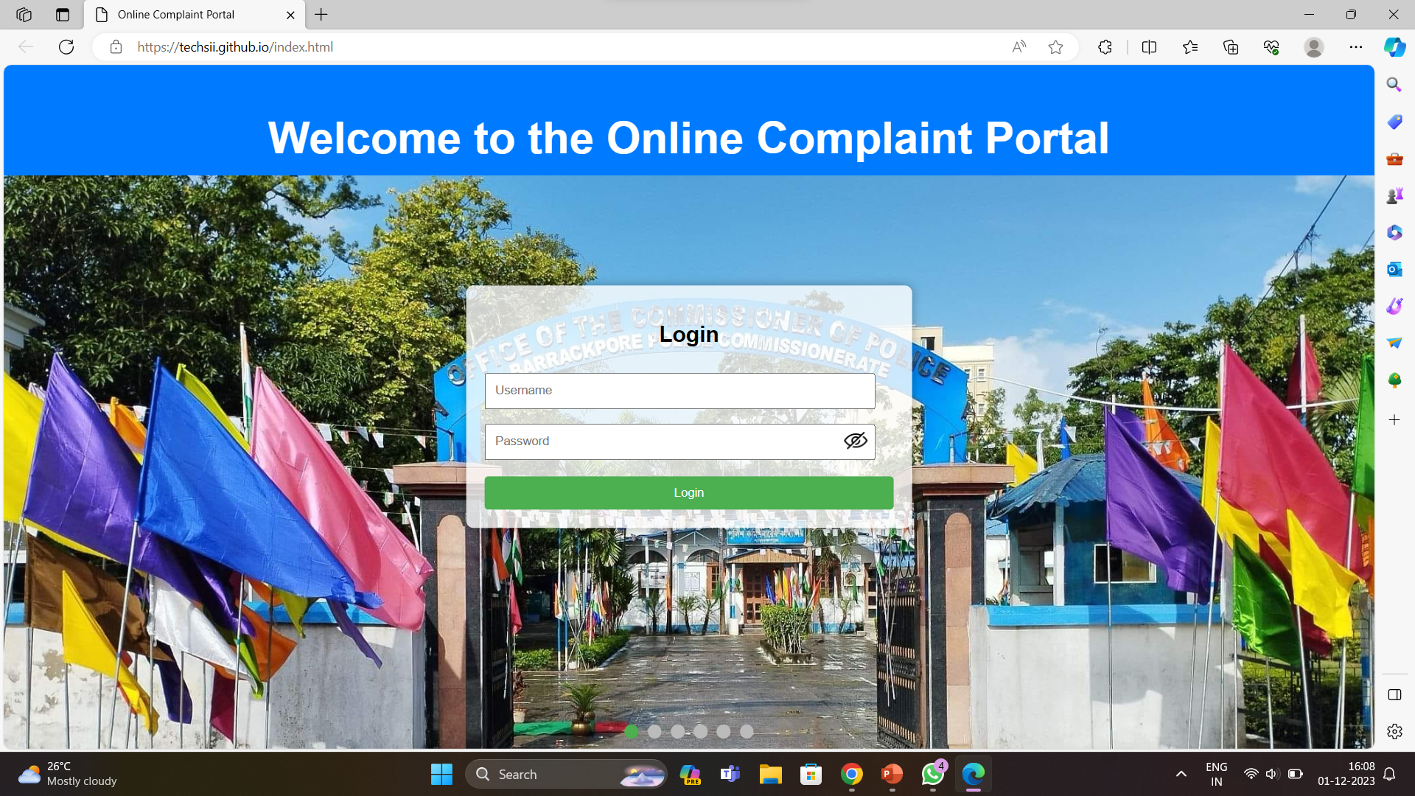
HOMEPAGE
Registering a complaint, first you have to create a account.
After registering , you can login using your id and password and register a complaint.

Slide 7
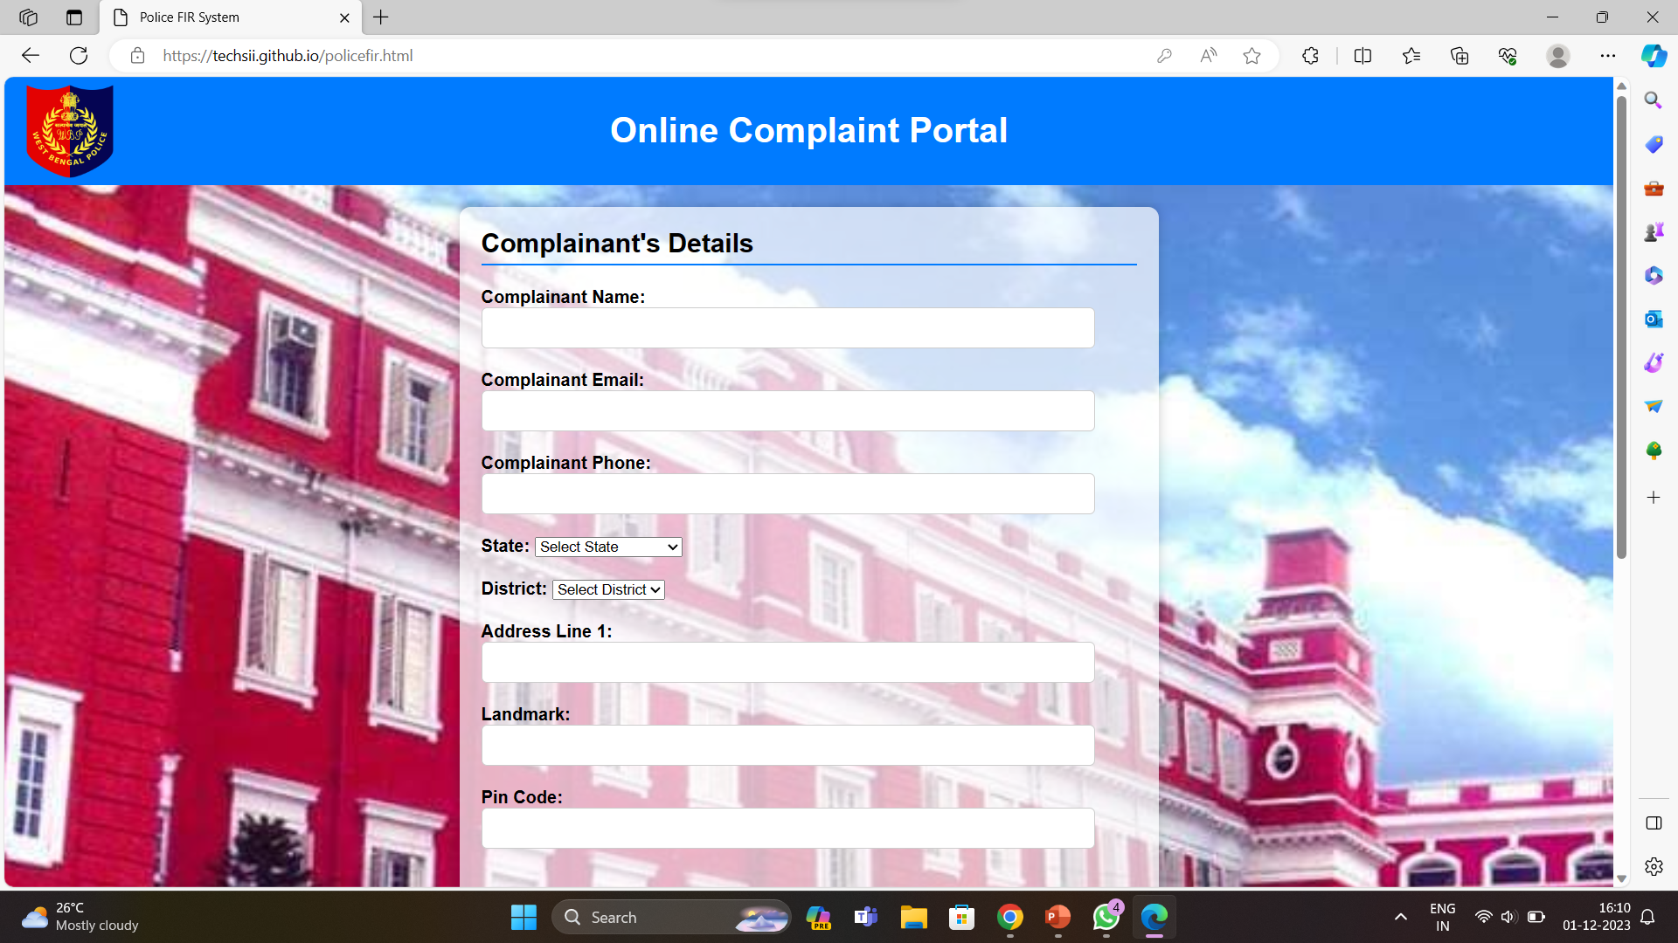
Once the user logs in, this page appears

Slide 8
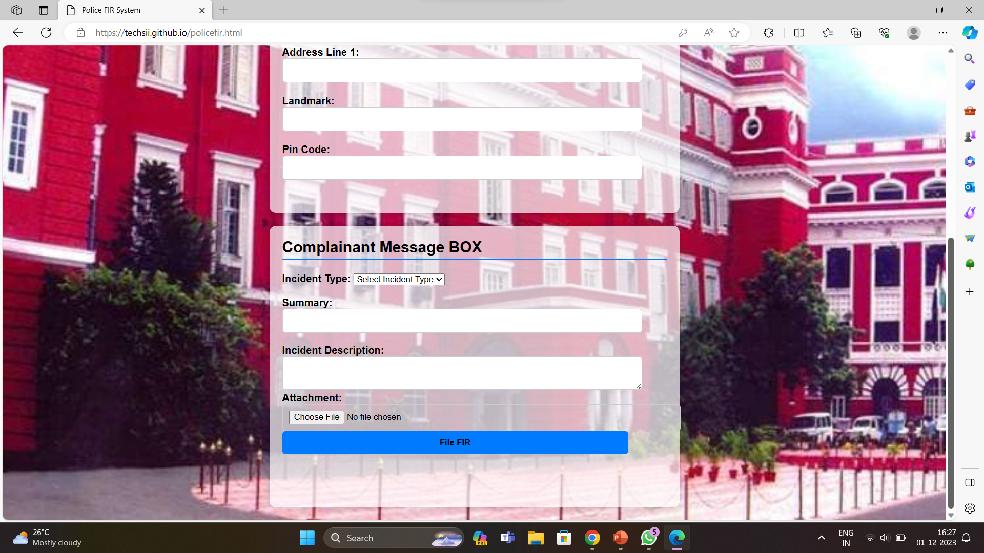
The user needs to fill in the required details

Slide 9
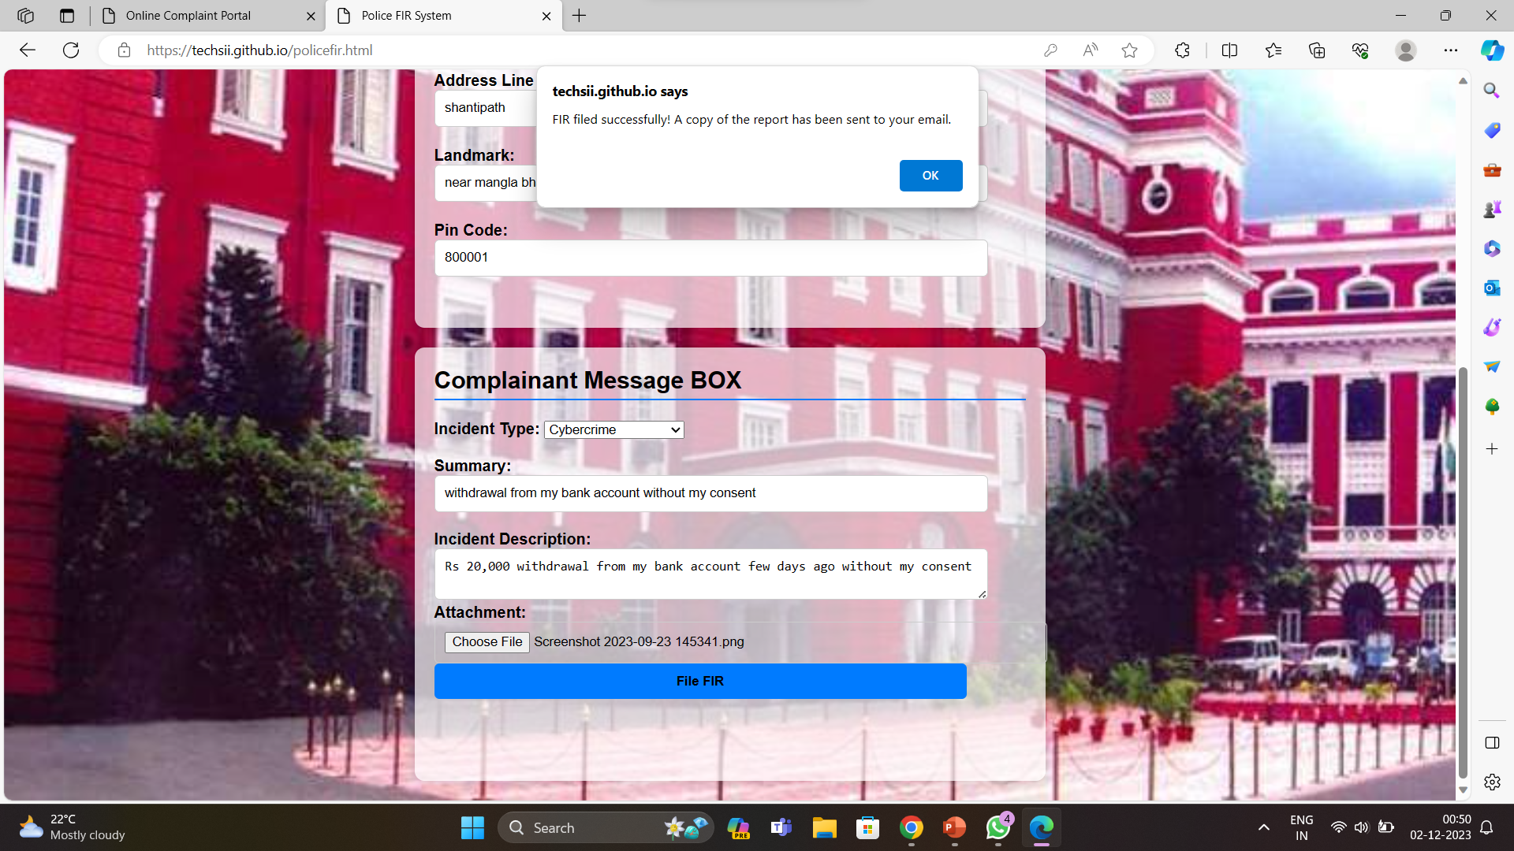
After your complaint has been successfully registered.
You will see a popup window showing ‘complaint filed successfully.

Slide 10
BACKEND DEVELOPMENT
For sending auto generated mail for registration success , we have used
SMTP server.
SMTP, or Simple Mail Transfer Protocol, is a protocol used for the transmission of electronic mail (email) over the internet.
As a computer science student preparing for a software developer job, understanding SMTP can be crucial, especially if you are dealing with email systems or developing applications that involve email communication.

Slide 11
Here are some key details about SMTP:
Purpose: SMTP is designed for sending emails from a client to a server or between servers. It works in conjunction with other protocols such as POP3 (Post Office Protocol) or IMAP (Internet Message Access Protocol), which are used for retrieving emails.
Port Number: SMTP typically uses port 25 for unencrypted communication and port 587 for encrypted communication (SMTP over TLS/SSL). Port 465 was previously used for SMTP over SSL but is now deprecated.
Communication Process:
The process begins with the client establishing a connection with the SMTP server.
The client then sends a series of commands to the server, specifying the sender's email address, recipient's email address, and the actual message data.
The server responds to each command with a status code, indicating success or failure.
If the recipient's server is different, the client's server might relay the email to the recipient's server.
Commands and Responses:
EHLO/HELO: The client identifies itself to the server.
MAIL FROM: Specifies the sender's email address.
RCPT TO: Specifies the recipient's email address.
DATA: Begins the data transfer phase, where the actual message content is sent.
QUIT: Terminates the session.

Slide 12
Security: SMTP by itself doesn't provide encryption, but it can be secured using additional protocols like STARTTLS or by utilizing SSL/TLS.
This is crucial for protecting sensitive information like email contents and login credentials during transmission.
Authentication: SMTP servers often require authentication to prevent unauthorized use. Common authentication mechanisms include LOGIN, PLAIN, CRAM-MD5, and DIGEST-MD5.
Extensions: SMTP has various extensions for enhanced functionality, such as SMTP Authentication, Delivery Status Notifications (DSN), and Secure SMTP (SMTPS).

Slide 13
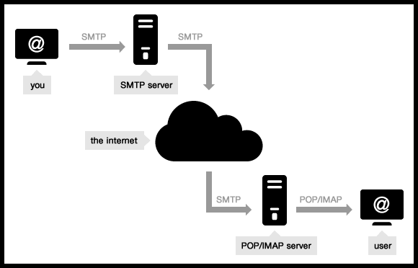
Understanding SMTP is valuable for anyone dealing with email systems, whether you're developing applications that send emails, configuring email servers, or troubleshooting email-related issues.
It's a fundamental aspect of internet communication, and its knowledge is beneficial for software developers working on projects involving email functionality

Slide 14

PROJECT LINK (GitHub)
Username – Neel2002
Password – Neel@2002
https://techsii.github.io/index.html
(Here is the link to open the project )

Slide 15

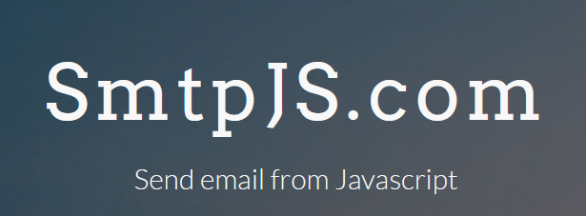

PROGRAMMING LANGUAGES USED
HTML
CSS
JAVASCRIPT
LIBRARY USED
SMTP.JS
IDE USED
VS CODE

Slide 16

Thank you

